Slide 1
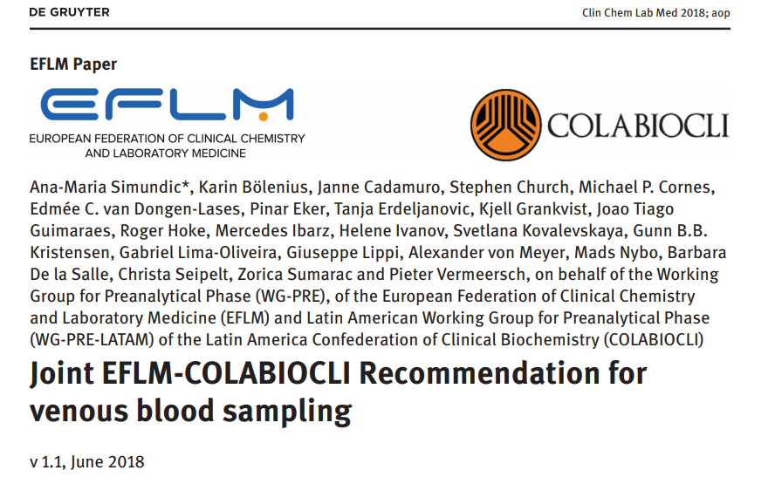
https://www.eflm.eu/site/page/a/1194
Version 1.1 / 2018

Slide 2
Why do we need guidelines?

Slide 3
Case #1
7:30 a.m.
Patient arrives at the laboratory outpatient unit. His last meal was at 21:00 on the previous day. In the morning he had coffee with milk (without sugar) and one cigarette. Routine chemistry and hematology tests are requested.
Is this patient properly prepared for blood tests?
Yes
No

Slide 4
Blood collection facts
Most common invasive procedure in the healthcare
Available worldwide (Hospitals, Primary Health Care, Home Based Care)
Huge variations in technique, use of safety devices, disposal methods, reuse of devices and availability of post exposure prophylaxis.
Variations between countries, institutions, individuals
The most common source of preanalytical errors.
Errors often go unrecognized.

Slide 5
Most preanalytical steps occur outside of the laboratory!
Blood Collection
Sample Transport
Lab Sample handling
(Documentation, Centrifugation, Distribution)
Analysis
Result Validation
(Technical, Medical)
Lab Report
Medical Decision
Why to test
(Indication)
What to test
(Parameter selection)
Interpretation
Interpretation
Postanalytical
Preanalytical
Laboratory
Clinics
Topic of this
presentation
Analytical
Notes:
This slide shows how errors in every single step of the preanalytics may lead to wrong medical decisions
It also shows, that most preanalytical steps occur outside of the laboratory

Slide 6
Errors within the total laboratory process
Error rate within the total laboratory process:
0.05% - 10 % of all samples
At what stage in the total laboratory process do these errors occur?
POSTANALYTIC
PREANALYTIC
23 %
15 %
62 %
ANALYTIC
Lippi G,et al Clin Chem Lab Med 2009; 47:143-153; Carraro P, Plebani M. Clin Chem 2007; 53:1338-1342.

Slide 7
Consequences of preanalytical errors
  Incorrect test results
  Incorrect diagnosis
  Unnecessary delays
  Harm to the patient and phlebotomist
  Unnecessary cost

Slide 8
Guidelines
CLSI GP41-A7 Procedures for the Collection of Diagnostic Blood Specimens by Venipuncture
Clinical and Laboratory Standards Institute
WHO guidelines on drawing blood
World Health Organization
http://apps.who.int/iris/bitstream/10665/44294/1/9789241599221_eng.pdf
National - Only 7/28 European countries have guidelines
  (Ireland, UK, Spain, Slovenia, Sweden, Italy and Croatia)
  Results from a survey 2013
  Different guidelines and different degrees of compliance
Simundic AM, et al. CCLM 2013;51(8):1585-93.

Slide 9
Case #2
7:00 a.m.
Patient is lying in his bed. Nurse arrives, asks the patient to sit upright in his bed, and draws one tube of blood. Serum proteins and cholesterol are requested.
Was it correct to ask the patient to sit upright?
  yes
  no

Slide 10
EFLM RECOMMENDED BLOOD COLLECTION PROCESS
EFLM-Guideline 2016

Slide 11
Pre-Sampling
Sampling
Post-Sampling
Patient identification
Patient preparation
Label tubes*
Communication
Workplace preparation
Test request
Assemble supplies
(Sanitize hands)
Release tourniquet
Draw first tube
Puncture the vein
Clean sampling site
Select puncture site
Apply tourniquet
Put on gloves
Gently invert tubes
Draw tubes in order
Remove needle
Dispose of needle
Bandage puncture site
Invert all tubes
Remove gloves
Advise patient
(Label tubes)*
Advise patient to rest
Transport the sample
* Depending on local risk assesment – see respective slide in this presentation

Slide 12
Pre-Sampling
Sampling
Post-Sampling
Patient identification
Patient preparation
Label tubes*
Communication
Workplace preparation
Test request
Assemble supplies
(Sanitize hands)
Release tourniquet
Draw first tube
Puncture the vein
Clean sampling site
Select puncture site
Apply tourniquet
Put on gloves
Gently invert tubes
Draw tubes in order
Remove needle
Dispose of needle
Bandage puncture site
Invert all tubes
Remove gloves
Advise patient
(Label tubes)*
Advise patient to rest
Transport the sample
* Depending on local risk assesment – see respective slide in this presentation

Slide 13
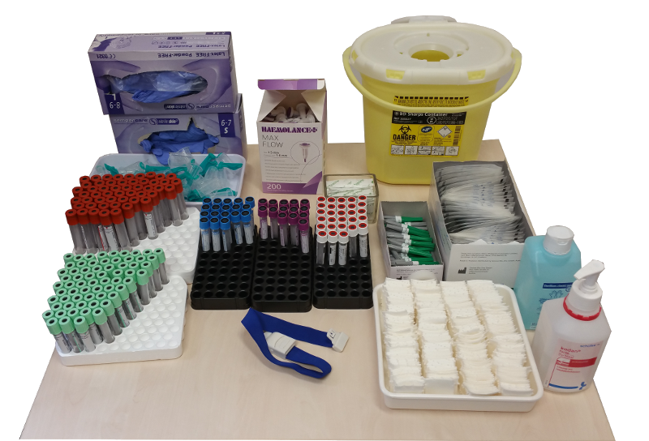
Workplace preparation
Ensure
Materials required
patient privacy
continuous workflow
undisturbed access to all necessary supplies.
supplies within expiry date
blood collection tubes
needles or winged blood collection sets with safety mechanism
needle holders
tourniquet
gloves
gauze pads, adhesive bandages, or tape
puncture-resistant sharps container
antiseptics: alcoholic and non-alcoholic disinfectants

Slide 14
Pre-Sampling
Sampling
Post-Sampling
Patient identification
Patient preparation
Label tubes*
Communication
Workplace preparation
Test request
Assemble supplies
(Sanitize hands)
Release tourniquet
Draw first tube
Puncture the vein
Clean sampling site
Select puncture site
Apply tourniquet
Put on gloves
Gently invert tubes
Draw tubes in order
Remove needle
Dispose of needle
Bandage puncture site
Invert all tubes
Remove gloves
Advise patient
(Label tubes)*
Advise patient to rest
Transport the sample
* Depending on local risk assesment – see respective slide in this presentation

Slide 15
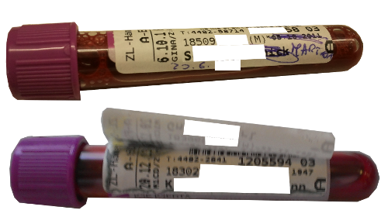
Patient Identification
ID errors are not rare!
  0.1-1% in laboratory medicine
  0.05% in transfusion medicine
Underreported (most go undetected)
Major healthcare issue
Potentially adverse consequences
ZERO TOLERANCE!
Any potentially mislabeled or misidentified specimen
must and will be rejected.
Lippi G, et al. CCLM 2011;49(7):1113–1126

Slide 16
Patient Identification
At least two independent identifiers:
  Patient full name (the first and the last name )
  Date of birth
Preferably one additional identifier:
  Address
  Health insurance number
  Patient identification number
  ID card details or any other personal identifier
Use open questions: “What is your name?” and “What is your date of birth?”
EFLM WG-PRE – Recommendation on Venous Blood Sampling; CLSI-Guideline GP41-A6

Slide 17
Patient Identification
If any discrepancies are identified
do not collect samples
until issues are resolved!*
*Exceptions: Unconscious patients, Immigrants without ID number, etc.

Slide 18
Pre-Sampling
Sampling
Post-Sampling
Patient identification
Patient preparation
Label tubes*
Communication
Workplace preparation
Test request
Assemble supplies
(Sanitize hands)
Release tourniquet
Draw first tube
Puncture the vein
Clean sampling site
Select puncture site
Apply tourniquet
Put on gloves
Gently invert tubes
Draw tubes in order
Remove needle
Dispose of needle
Bandage puncture site
Invert all tubes
Remove gloves
Advise patient
(Label tubes)*
Advise patient to rest
Transport the sample
* Depending on local risk assesment – see respective slide in this presentation

Slide 19
Patient preparation
Consider:
Has the patient fasted
Has the patient been involved in recent physical activity
Patient positioning
Patient medication / Infusion
Time of day
Test-specific requirements

Slide 20
Fasting
Blood for all tests should be drawn preferably
in the morning from 7 to 9 a.m. after fasting
(before breakfast / medication)
Simundic AM et al. Clin Chim Acta 2014;432:33-7

Slide 21
Fasting
How long to wait before blood collection
Food and liquid
(except water)
Alcohol
Smoking
Caffeine
12 hours
24 hours
Refrain on the day of blood sampling
Special Situations: e.g.
Pineapple, Avocado, Banana, Kiwi, Tomato, etc → Serotonin ↑
Protein-rich meals → Homocysteine ↑
Simundic AM et al. Clin Chim Acta 2014;432:33-7
Nikolac N et al. Biochem Med 2013;23(3):242-54.

Slide 22
Fasting
Parameter | Relative Change 1-6h after standard meal
Triglycerides | 10 – 21%
Total Cholesterol | 1 – 8%
LDL Cholesterol | 4 – 9%
HDL Cholesterol | 0 – 6%
Nordestgaard BG et al.. Eur Heart J 2016.

Slide 23
Fasting
What to do if non-fasting blood collection is impossible?
Document that the patient was not fasting to guide later interpretation.
Kackov, S et al. Biochem Med 2013;23(3):326–31

Slide 24
Case #1
Result
7:30 a.m.
Patient arrives at the laboratory outpatient unit. His last meal was at 21:00 on the previous day. In the morning he had coffee with milk (without sugar) and one cigarette. Routine chemistry and hematology tests are requested.
Is this patient properly prepared for blood tests?
Yes
No

Slide 25
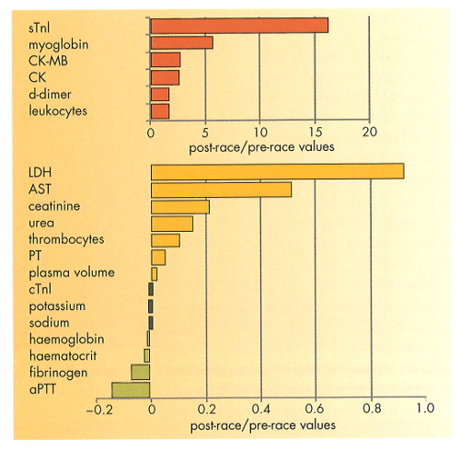
Physical activity
Effects of marathon running
Blood collected 1-3 days before and 1 hour after finishing the race
Even moderate exercise (e.g. running to the doctor’s office) can influence laboratory parameters
Guder WG, Narayanan S, Wisser H, Zawta B: Diagnostic Samples: From the Patient to the Laboratory, 4th ed.2009
Copyright Wiley-VCH Verlag GmbH & Co. KGaA. Reproduced with permission.

Slide 26
What to ask the patient
When was your last meal?
When was your last drink?
What was it?
Have you performed any unusal physical activity in the last 24 hours?
(„Unusual“ for that specific patient)

Slide 27
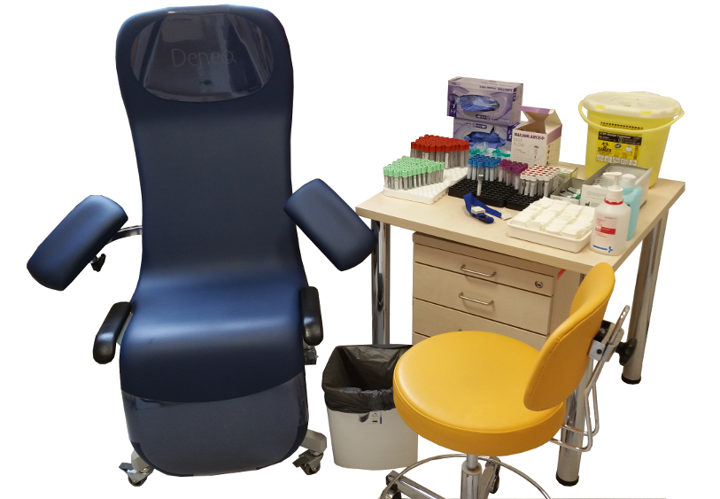
Patient Positioning
Patient should be sitting in a comfortable chair with arms to provide support in case the patient faints
If necessary, patient may lie down
Do not change position
before blood sampling!
(if possible)

Slide 28
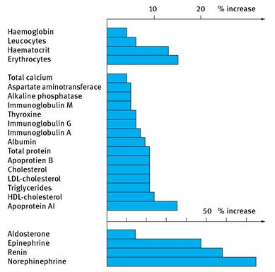
Patient Positioning
Change from supine to upright position
Blood collection preferably after 15 minutes rest in one position
Guder WG, Narayanan S. Pre-Examination Procedures in Laboratory Diagnostics. 1st ed. DeGruyter, Berlin 2015

Slide 29
Case #2
7:00 a.m.
Patient is lying in his bed. Nurse arrives, asks the patient to sit upright in his bed, and draws one tube of blood. Serum proteins and cholesterol are requested.
Was it correct to ask the patient to sit upright?
  yes
  no

Slide 30
Medication / Infusion
Therapeutic drug monitoring
Always after steady state has been reached
Always document / inform the lab:
WHAT (drug did the patient receive)?
HOW MUCH (of the drug did the patient receive)?
WHEN (was the last intake)?

Slide 31
Medication / Infusion
Many medications interfere (in-vivo / in-vitro) with laboratory tests.
Examples:
If not avoidable: Blood collection immediately prior to taking the next dose of the drug including information on WHAT? / WHEN? / HOW MUCH?
Medication | Parameter affected
Anticoagulant therapy | Coagulation testing
Aspirin | Platelet function
Supplements containing iron within the last 10 days | Iron
Insulin | Glucose
Levethyroxine | T4/fT4
Nikolac N et al. Biochem Med 2013;23(3):242-54.

Slide 32
Blood collection using an IV catheter
Whenever possible avoid drawing blood through an
IV catheter.
Catheter collection can impact sample quality through the creation of significantly more hemolysis in samples, sample dilution and contamination of samples
If unavoidable only collect after from a newly inserted catheter, and ideally not after/during infusion, use manual aspiration technique or partial draw blood collection tubes*
*Partial draw tubes are tubes which are designed not be filled completely (e.g. 16x100mm / 4ml)

Slide 33
Medication / Infusion
Turn off any infusion before blood collection if possible
Blood collection always on the other arm or distal to the infusion site
Recommendation:
Infusion | Earliest time of blood sampling after infusion has been stopped
Lipid | 8 hours
Glucose | 1 hour
Electrolytes | 1 hour
Protein | 1 hour
Adapted from Guder W et al, Diagnostic Samples: From the Patient to the Laboratory, 4th ed.,Wiley-Blackwell, Weinheim, 2009

Slide 34
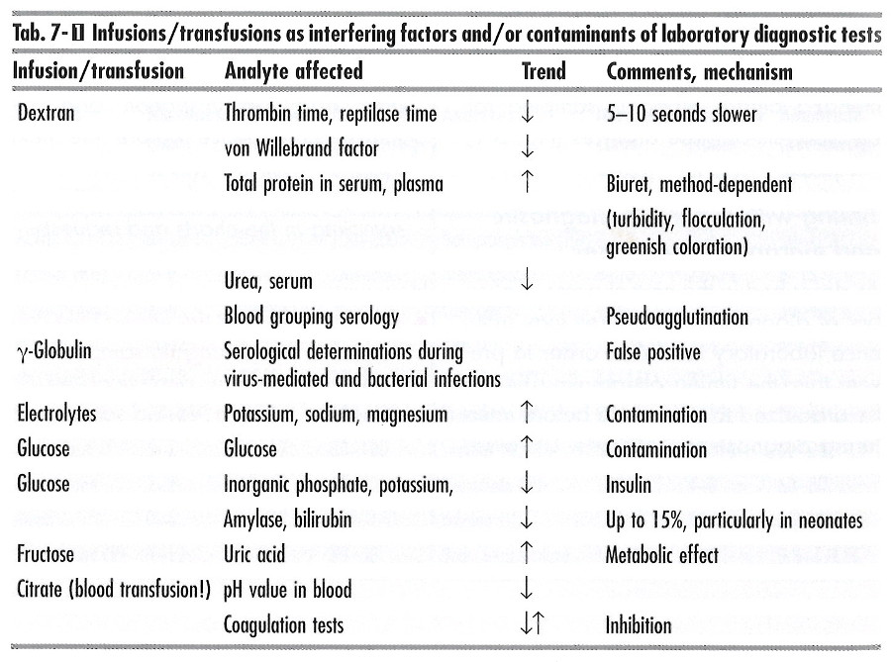
Medication / Infusion
Guder WG, Narayanan S, Wisser H, Zawta B: Diagnostic Samples: From the Patient to the Laboratory, 4th ed.2009
Copyright Wiley-VCH Verlag GmbH & Co. KGaA. Reproduced with permission.

Slide 35
Time of day
Blood for all tests should be drawn preferably
in the morning from 7 to 9 a.m.
(before breakfast / medication)
Simundic AM et al. Clin Chim Acta 2014;432:33-7

Slide 36
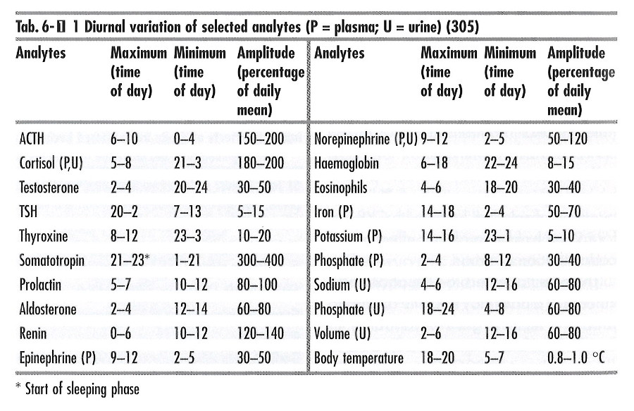
Time of day
Guder WG, Narayanan S, Wisser H, Zawta B: Diagnostic Samples: From the Patient to the Laboratory, 4th ed.2009
Copyright Wiley-VCH Verlag GmbH & Co. KGaA. Reproduced with permission.

Slide 37
Pre-Sampling
Sampling
Post-Sampling
Patient identification
Patient preparation
Label tubes*
Communication
Workplace preparation
Test request
Assemble supplies
(Sanitize hands)
Release tourniquet
Draw first tube
Puncture the vein
Clean sampling site
Select puncture site
Apply tourniquet
Put on gloves
Gently invert tubes
Draw tubes in order
Remove needle
Dispose of needle
Bandage puncture site
Invert all tubes
Remove gloves
Advise patient
(Label tubes)*
Advise patient to rest
Transport the sample
* Depending on local risk assesment – see respective slide in this presentation
Notes:
“Label tubes”: Tube labelling must be done in presence of the patient. Labelling before or after blood collection should be based on a prospective risk analysis of the phlebotomy process in each institution.

Slide 38
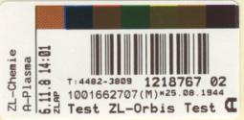
Label tubes
Tube labelling or tube cross-identification must be done in the presence of the patient. Labelling before or after blood collection should be based on a prospective risk analysis of the blood collection process in each institution.
Tube information should at least contain:
    Patient first and last name
    Date of birth
    ID number
    Preferable additional information on the tube:
    Date
    Time (if necessary, e.g. for TDM)
    ID of the phlebotomist
    (or there should be a mechanism to identify a phlebotomist)
If this information is not printed directly on the label, a mechanism must be in place to identify this information for example through IT systems (e.g. laboratory/hospital information systems)
EFLM WG-PRE – Recommendation on Venous Blood Sampling; CLSI-Guideline GP41-A6

Slide 39
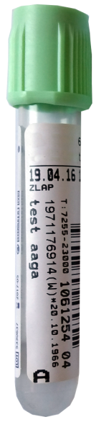
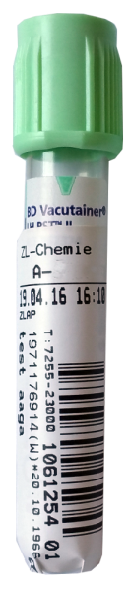
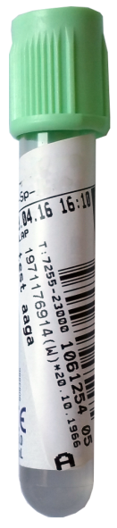
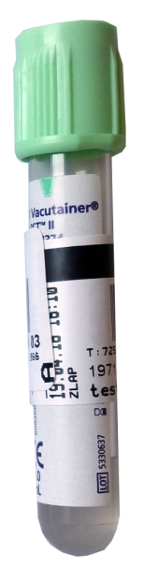
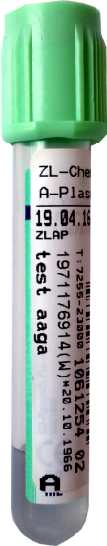
Label tubes
Visible fill line
Labelled straight vertically
Labelled high
Labelled horizontally
Labelled too low
X
X
X
X
Labelled all around
(Fill line not visible)
Labelled askew

Slide 40
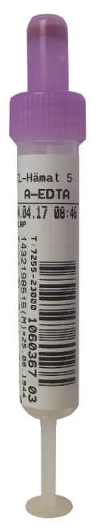
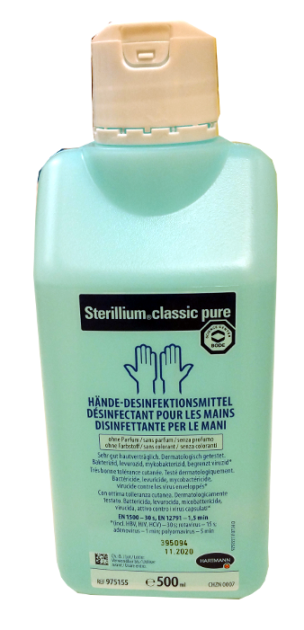
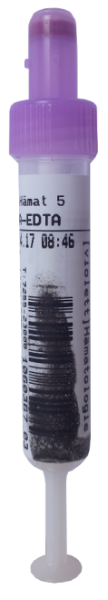
Label tubes
Avoid contact of the label with disinfectant
+
=

Slide 41
Pre-Sampling
Sampling
Post-Sampling
Patient identification
Patient preparation
Label tubes*
Communication
Workplace preparation
Test request
Assemble supplies
(Sanitize hands)
Release tourniquet
Draw first tube
Puncture the vein
Clean sampling site
Select puncture site
Apply tourniquet
Put on gloves
Gently invert tubes
Draw tubes in order
Remove needle
Dispose of needle
Bandage puncture site
Invert all tubes
Remove gloves
Advise patient
(Label tubes)*
Advise patient to rest
Transport the sample
* Depending on local risk assesment – see respective slide in this presentation
Notes:
„sanitize hands“: Cleaning of hands in front of patients is also important in reassuring a patient, but is not necessary if gloves are worn.

Slide 42
Put on gloves / Sanitize hands
Cleaning of hands in front of patients is also important in reassuring a patient.
To minimize blood stasis it is recommended putting on gloves prior to tourniquet application.
Always use a new pair of gloves for each patient.
Lima-Oliveira G, et al. Biochemia Medica 2012;22(3):342-51.

Slide 43
Pre-Sampling
Sampling
Post-Sampling
Patient identification
Patient preparation
Label tubes*
Communication
Workplace preparation
Test request
Assemble supplies
(Sanitize hands)
Release tourniquet
Draw first tube
Puncture the vein
Clean sampling site
Select puncture site
Apply tourniquet
Put on gloves
Gently invert tubes
Draw tubes in order
Remove needle
Dispose of needle
Bandage puncture site
Invert all tubes
Remove gloves
Advise patient
(Label tubes)*
Advise patient to rest
Transport the sample
* Depending on local risk assesment – see respective slide in this presentation

Slide 44
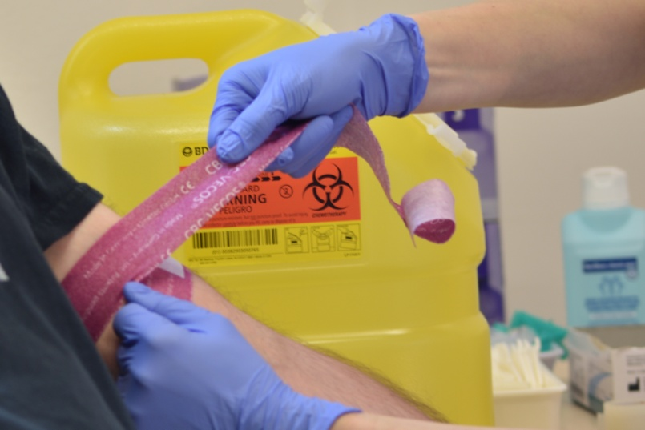
Apply tourniquet
Apply tourniquet only if necessary.
EFLM-recommendation: Collect blood without tourniquet whenever possible.
Try to minimize the use of a tourniquet for the following collections:
  lactate
  ammonia
  albumin
  calcium
Tourniquets are a source of MRSA
(Through poor hand hygiene. Therefore use single-use devices!)

Slide 45
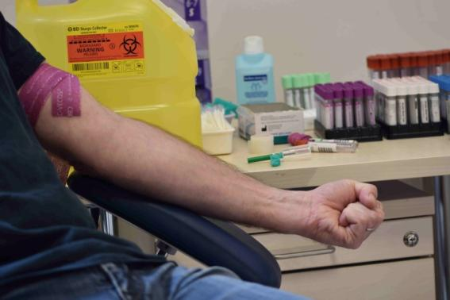
Apply tourniquet
When using a tourniquet:
7 - 10 cm (4–5 finger width) proximal to the puncture site
Release ≤ 1 minute (If > 1 minute, release and reapply after 2 min)
Pumping (fist clenching) should not be done!

Slide 46
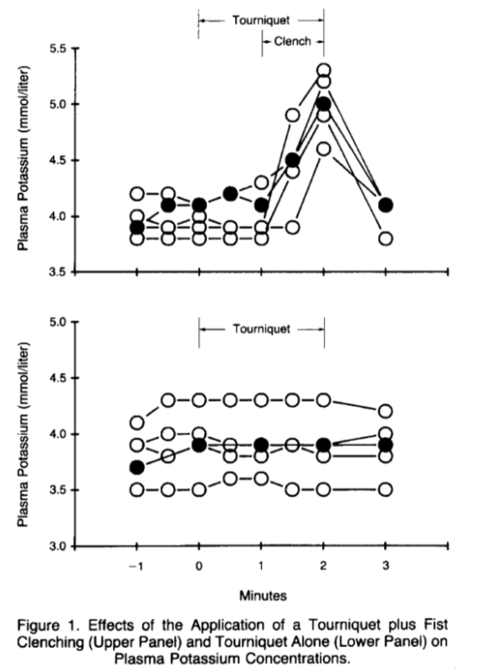
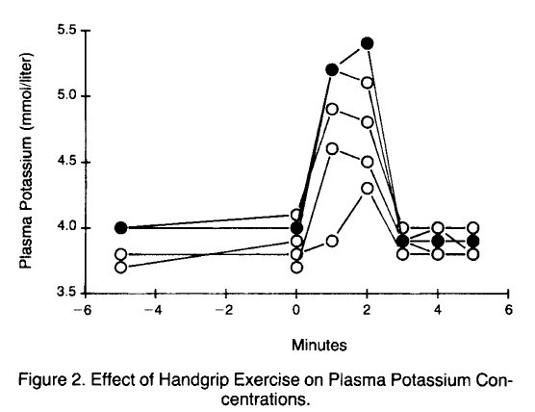
Apply tourniquet
Fist clenching leads to an increase in potassium !!
Don BR et al. N Engl J Med 1990;322(18):1290-2.

Slide 47
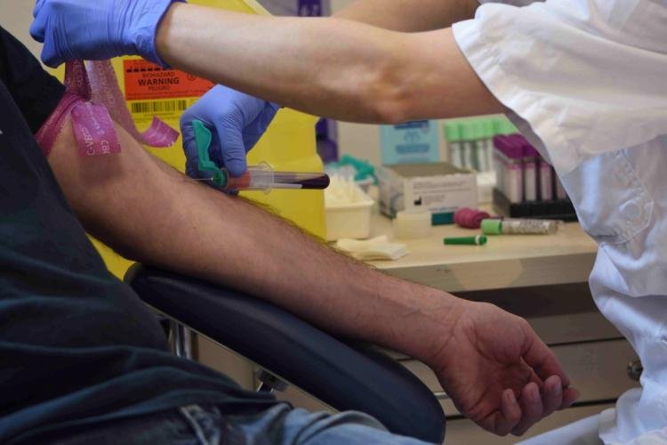
Release Tourniquet
As soon as possible after the
blood begins to flow into tube

Slide 48
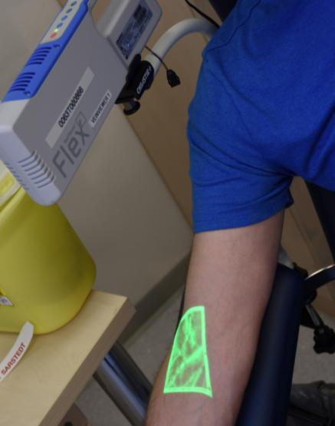
Helpful tools
Vein illumination device
for better vizualisation of the veins
Vein Viewer® Flex – Greiner BioOne

Slide 49
Pre-Sampling
Sampling
Post-Sampling
Patient identification
Patient preparation
Label tubes*
Communication
Workplace preparation
Test request
Assemble supplies
(Sanitize hands)
Release tourniquet
Draw first tube
Puncture the vein
Clean sampling site
Select puncture site
Apply tourniquet
Put on gloves
Gently invert tubes
Draw tubes in order
Remove needle
Dispose of needle
Bandage puncture site
Invert all tubes
Remove gloves
Advise patient
(Label tubes)*
Advise patient to rest
Transport the sample
* Depending on local risk assesment – see respective slide in this presentation

Slide 50
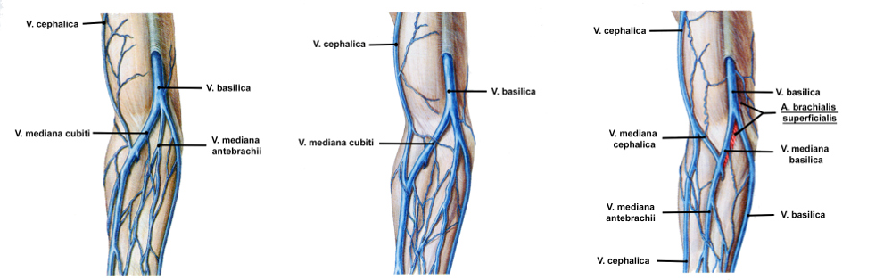
Select a puncture site
Selecting the best vein for venipuncture is important:
  sample quality,
  patient satisfaction,
  to avoid nerve damage,
  to avoid arterial puncture,
  ease and speed of collection
  Do not collect blood from:
  previously placed peripheral venous catheters
  indurated veins
  paretic arm
  arms with lymphatic drain disorders
Putz R and Pabst R eds. Sobotta: Atlas of Human Anatomy. 20th ed. Munich, DE: Urban & Schwarzenberg/Elsevier, 1993.
Reprinted with kind permission of the Elsevier GmbH

Slide 51
Pre-Sampling
Sampling
Post-Sampling
Patient identification
Patient preparation
Label tubes*
Communication
Workplace preparation
Test request
Assemble supplies
(Sanitize hands)
Release tourniquet
Draw first tube
Puncture the vein
Clean sampling site
Select puncture site
Apply tourniquet
Put on gloves
Gently invert tubes
Draw tubes in order
Remove needle
Dispose of needle
Bandage puncture site
Invert all tubes
Remove gloves
Advise patient
(Label tubes)*
Advise patient to rest
Transport the sample
* Depending on local risk assesment – see respective slide in this presentation

Slide 52
Clean sampling site
CLSI GP41-A7 guideline recommends that the puncture site must be cleaned to prevent contamination of a patient or a sample
Use 70% ethyl alcohol
For blood culture collection let alcohol dry for a minimum of 60 seconds
When collecting a sample for alcohol concentration measurements, the use a non-alcoholic disinfectant is preferable.
Clean site with on wipe and let it dry.
To prevent hemolysis
To prevent patient experiencing a burning sensation during puncture
To allow the alcohol to sterilise the puncture site
Lippi G et al. Biochem Med 2017; 27(2):398-403
Failure to let alcohol dry is not associated with sample hemolysis !
Salvagno GL et al. Biochem Med 2013;23(2):201-5.

Slide 53
Pre-Sampling
Sampling
Post-Sampling
Patient identification
Patient preparation
Label tubes*
Communication
Workplace preparation
Test request
Assemble supplies
(Sanitize hands)
Release tourniquet
Draw first tube
Puncture the vein
Clean sampling site
Select puncture site
Apply tourniquet
Put on gloves
Gently invert tubes
Draw tubes in order
Remove needle
Dispose of needle
Bandage puncture site
Invert all tubes
Remove gloves
Advise patient
(Label tubes)*
Advise patient to rest
Transport the sample
* Depending on local risk assesment – see respective slide in this presentation

Slide 54
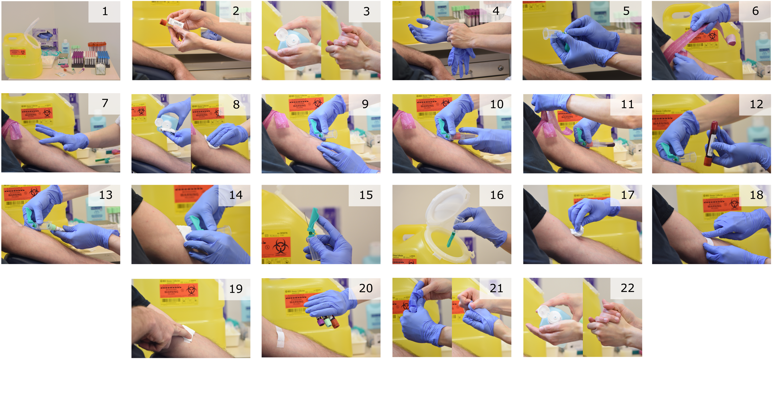
Puncture the vein - Vacuum System
1 Ensure appropriate conditions and supplies
required for phlebotomy
2 Label and/or identify tubes
3 Clean hands in front of the patient
4 Put on gloves
5 Assemble appliances
6 Apply tourniquet
7 Select venepuncture site
8 Clean sampling site
9 Puncture the vein
10 Draw first tube
11 Release the tourniquet as soon as the
blood flows into the first tube
12 Gently invert the tubes 1 time
immediately after collection
13 Draw additional tubes following order of draw
14 Remove needle from the vein
15 Activate safety mechanism
16 Dispose of the needle
17 Ensure the bleeding has stopped
18 Treat the puncture wound
19 Tell a patient to apply a pressure on the wound
20 Invert all tubes 4 times
21 Remove gloves
22 Clean hands

Slide 55
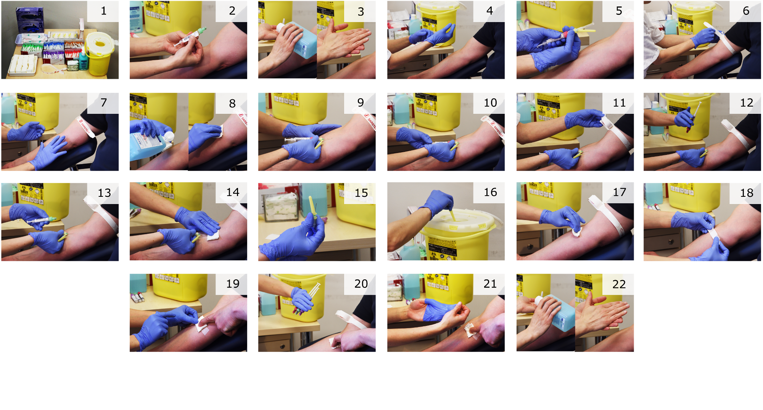
Puncture the vein - Aspiration System
1 Ensure appropriate conditions and supplies
required for phlebotomy
2 Label and/or identify tubes
3 Clean hands in front of the patient
4 Put on gloves
5 Assemble appliances
6 Apply tourniquet
7 Select venepuncture site
8 Clean sampling site
9 Puncture the vein
10 Draw first tube
11 Release the tourniquet as soon as the
blood flows into the first tube
12 Gently invert the tubes 1 time
immediately after collection
13 Draw additional tubes following order of draw
14 Remove needle from the vein
15 Activate safety mechanism
16 Dispose of the needle
17 Ensure the bleeding has stopped
18 Treat the puncture wound
19 Tell a patient to apply a pressure on the wound
20 Invert all tubes 4 times
21 Remove gloves
22 Clean hands

Slide 56
Puncture the vein
Puncture the vein with the bevel up, as it minimizes the pain and reduces the risk of perforation of the back wall of the vein
If the first blood collection attempt is unsuccessful, the second attempt should be made on the other arm.
If a third attempt should be necessary, it should be performed distal to the previous puncture sites. Also consider calling a more experienced colleague.

Slide 57
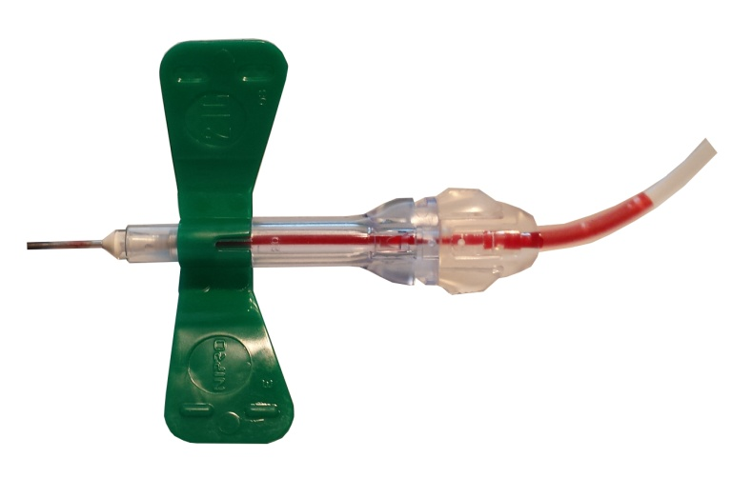
Helpful tools
Sharps device with flash visualisation
Needle & wingsets are available that either through design or as part of the method of operation that will provide a visible flash indication when the needle has penetrated the vein
Image: With kind permission from Becton Dickinson ©

Slide 58
Blood borne pathogens
Possible transmission of a variety of pathogens including HIV, Hepatitis B + C, and other
Use medical devices incorporating a safety-engineered protection mechanism
Place effective disposal procedures and clearly marked and technically safe sharps containers
Use Personal Protective Equipment (Gloves)
NEVER recap a used needle

Slide 59
Pre-Sampling
Sampling
Post-Sampling
Patient identification
Patient preparation
Label tubes*
Communication
Workplace preparation
Test request
Assemble supplies
(Sanitize hands)
Release tourniquet
Draw first tube
Puncture the vein
Clean sampling site
Select puncture site
Apply tourniquet
Put on gloves
Gently invert tubes
Draw tubes in order
Remove needle
Dispose of needle
Bandage puncture site
Invert all tubes
Remove gloves
Advise patient
(Label tubes)*
Advise patient to rest
Transport the sample
* Depending on local risk assesment – see respective slide in this presentation

Slide 60
Case #3
Nurse needs to draw EDTA, serum and citrate tubes from a patient. Which is the correct order of draw?
Coagulation (citrate) > EDTA > Serum
EDTA > Coagulation (citrate) > Serum
Coagulation (citrate) > Serum > EDTA
The order of draw does not matter. It is not important.

Slide 61
Order of draw
Important to:
assure sample quality
avoid cross-contamination of additives between tubes
Evidence shows that it occurs and may affect the quality of results
Cornes MP et al. Clin Chem Lab Med 2013; 51:e285 - e285.

Slide 62
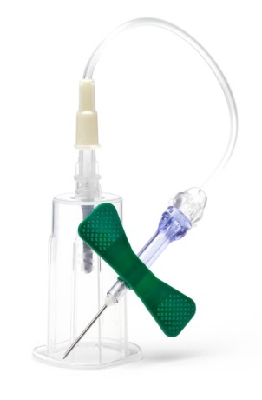
Order of draw
Coagulation tube as first tube?
When using a winged safety blood collection set, a discard tube must be used to prevent underfilling.
No discard tube is needed when
straight needles are used for
blood collection.
Image with kind permission of Greiner Bio-One©
EFLM-Guideline on Venous blood collection; CLSI H21-A5 ; CLSI GP41-A6

Slide 63
Order of draw
EFLM WG-PRE Recommendation
In agreement with ISO 6710:1995 Preview
Single-use containers for venous blood specimen collection
Blood culture
Citrate tube |  | ESR*
Serum tube with or without barrier
Heparin tubes with or without barrier
EDTA tubes
Glucose tubes
Other tubes (e.g. trace elements)
Cap colors in your hospital might differ, please refer to your laboratory
*Erythrocyte sedimentation rate

Slide 64
Case #3
Nurse needs to draw EDTA, serum and citrate tubes from a patient. Which is the correct order of draw?
Coagulation (citrate) > EDTA > Serum
EDTA > Coagulation (citrate) > Serum
Coagulation (citrate) > Serum > EDTA
The order of draw does not matter. It is not important.

Slide 65
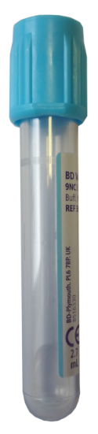
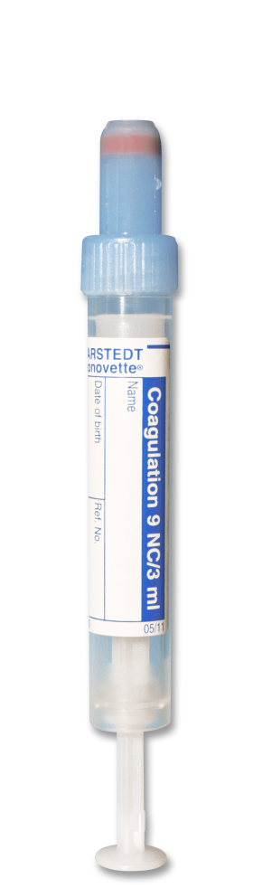
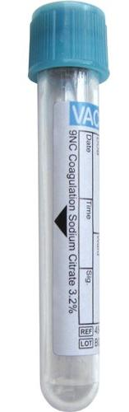
Tube filling
Minimum
Consequence of underfilled coagulation tube:
Too much citrate per ml blood
→ Incorrect coagulation results
Even slightly underfilled tubes may lead to erroneous coagulation results
Maximum
Minimum
Images with kind permission of Becton Dickinson © , GBO © , Sarstedt ©

Slide 66
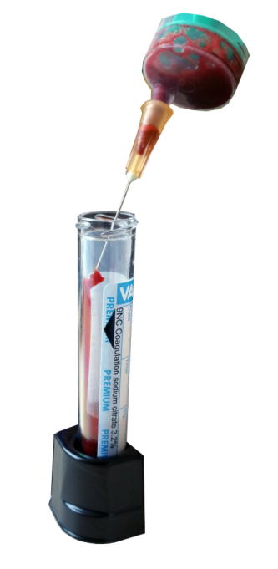
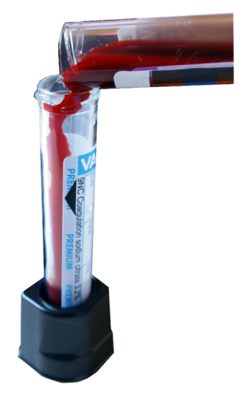
Tube filling
Never transfer blood from a syringe or another blood collection tube !!!!

Slide 67
Pre-Sampling
Sampling
Post-Sampling
Patient identification
Patient preparation
Label tubes*
Communication
Workplace preparation
Test request
Assemble supplies
(Sanitize hands)
Release tourniquet
Draw first tube
Puncture the vein
Clean sampling site
Select puncture site
Apply tourniquet
Put on gloves
Gently invert tubes
Draw tubes in order
Remove needle
Dispose of needle
Bandage puncture site
Invert all tubes
Remove gloves
Advise patient
(Label tubes)*
Advise patient to rest
Transport the sample
* Depending on local risk assesment – see respective slide in this presentation

Slide 68
Remove needle from the vein
After disconnecting the last tube place a gauze on the venipuncture area, without applying pressure.
Gently remove the needle and immediately activate the safety mechanism
Apply pressure to the puncture site with the gauze to prevent bleeding

Slide 69
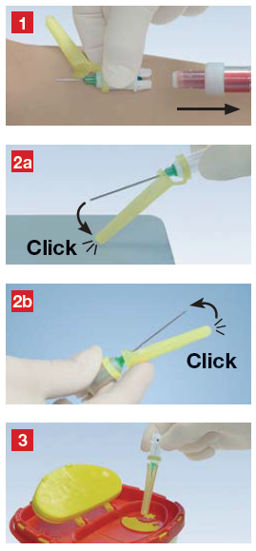
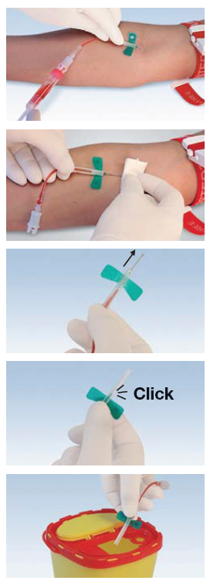

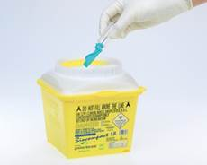
Activate Safety Device and dispose needle
Aspiration
system
Evacuated blood collection
system
Butterfly
Images with kind permission of Sarstedt and Greiner Bio-One©

Slide 70
Pre-Sampling
Sampling
Post-Sampling
Patient identification
Patient preparation
Label tubes*
Communication
Workplace preparation
Test request
Assemble supplies
(Sanitize hands)
Release tourniquet
Draw first tube
Puncture the vein
Clean sampling site
Select puncture site
Apply tourniquet
Put on gloves
Gently invert tubes
Draw tubes in order
Remove needle
Dispose of needle
Bandage puncture site
Invert all tubes
Remove gloves
Advise patient
(Label tubes)*
Advise patient to rest
Transport the sample
* Depending on local risk assesment – see respective slide in this presentation

Slide 71
Bandage puncture site and advise Patient
Check that the bleeding has stopped. Apply an adhesive bandage securely over a dry pad/gauze square.
Ask the patient to apply pressure for at least 2 minutes for routine draws and up to 10 minutes for patients on anticoagulation.
If cephalic basilic vein is used, ask the patient not to bend the arm

Slide 72
Pre-Sampling
Sampling
Post-Sampling
Patient identification
Patient preparation
Label tubes*
Communication
Workplace preparation
Test request
Assemble supplies
(Sanitize hands)
Release tourniquet
Draw first tube
Puncture the vein
Clean sampling site
Select puncture site
Apply tourniquet
Put on gloves
Gently invert tubes
Draw tubes in order
Remove needle
Dispose of needle
Bandage puncture site
Invert all tubes
Remove gloves
Advise patient
(Label tubes)*
Advise patient to rest
Transport the sample
* Depending on local risk assesment – see respective slide in this presentation

Slide 73
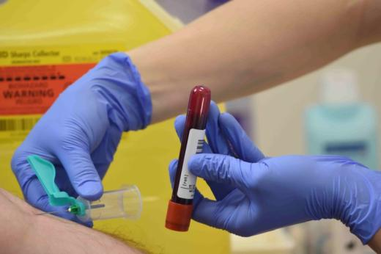
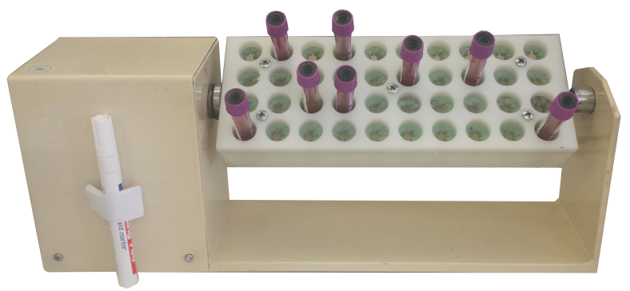
Invert tubes
Blood must be mixed with anticoagulant
Invert tubes gently 1x directly after collection and
4x after collection of all tubes
If only one tube is collected, invert 5 x directly after collection.
No mixing → Risk of clotted sample and latent clotting in serum samples
Do NOT shake the sample → sample hemolysis !

Slide 74
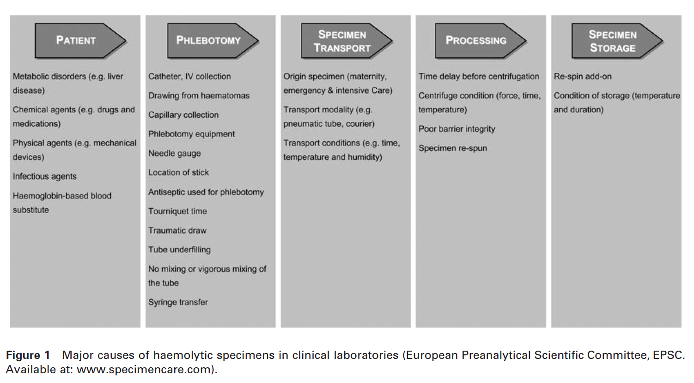
Sample hemolysis
Lippi G, et al. Clin Chem Lab Med 2008; 46:764-772.

Slide 75
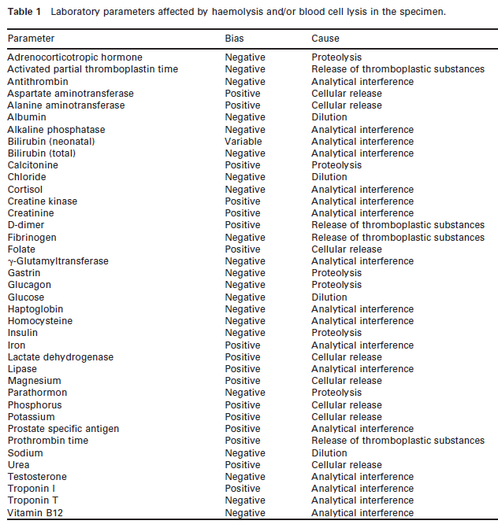
Sample hemolysis
Consequences
Interference with chromatic measurements
Release of intracellular components after erythrocyte rupture
Lippi G, et al. Clin Chem Lab Med 2008; 46:764-772.

Slide 76
Pre-Sampling
Sampling
Post-Sampling
Patient identification
Patient preparation
Label tubes*
Communication
Workplace preparation
Test request
Assemble supplies
(Sanitize hands)
Release tourniquet
Draw first tube
Puncture the vein
Clean sampling site
Select puncture site
Apply tourniquet
Put on gloves
Gently invert tubes
Draw tubes in order
Remove needle
Dispose of needle
Bandage puncture site
Invert all tubes
Remove gloves
Advise patient
(Label tubes)*
Advise patient to rest
Transport the sample
* Depending on local risk assesment – see respective slide in this presentation

Slide 77
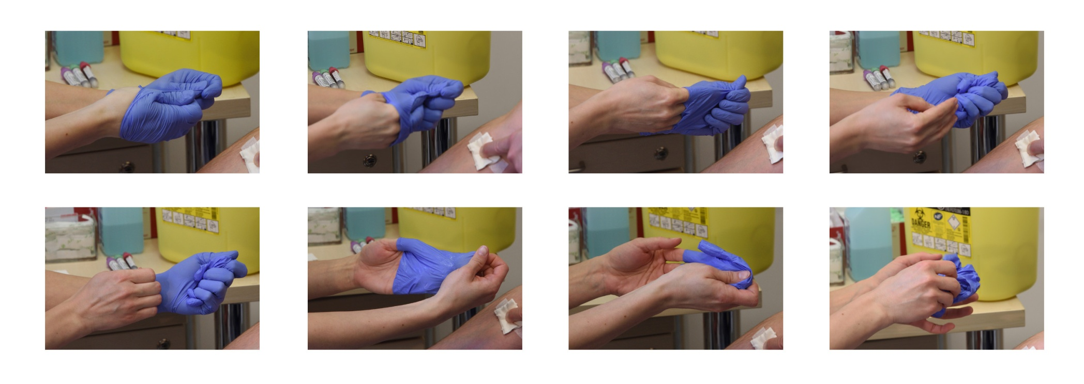
Remove gloves
Always remove gloves by turning them inside out.
Before removing the second glove place the first one in your fist.
Thereby you should have one bundle with all potentially infectious substances facing inwards.

Slide 78
Pre-Sampling
Sampling
Post-Sampling
Patient identification
Patient preparation
Label tubes*
Communication
Workplace preparation
Test request
Assemble supplies
(Sanitize hands)
Release tourniquet
Draw first tube
Puncture the vein
Clean sampling site
Select puncture site
Apply tourniquet
Put on gloves
Gently invert tubes
Draw tubes in order
Remove needle
Dispose of needle
Bandage puncture site
Invert all tubes
Remove gloves
Advise patient
(Label tubes)*
Advise patient to rest
Transport the sample
* Depending on local risk assesment – see respective slide in this presentation

Slide 79
Advise patient to rest
Advise patient to rest for 5 minutes and ensure bleeding has stopped before leaving the area where blood collection took place

Slide 80
Pre-Sampling
Sampling
Post-Sampling
Patient identification
Patient preparation
Label tubes*
Communication
Workplace preparation
Test request
Assemble supplies
(Sanitize hands)
Release tourniquet
Draw first tube
Puncture the vein
Clean sampling site
Select puncture site
Apply tourniquet
Put on gloves
Gently invert tubes
Draw tubes in order
Remove needle
Dispose of needle
Bandage puncture site
Invert all tubes
Remove gloves
Advise patient
(Label tubes)*
Advise patient to rest
Transport the sample
* Depending on local risk assesment – see respective slide in this presentation

Slide 81
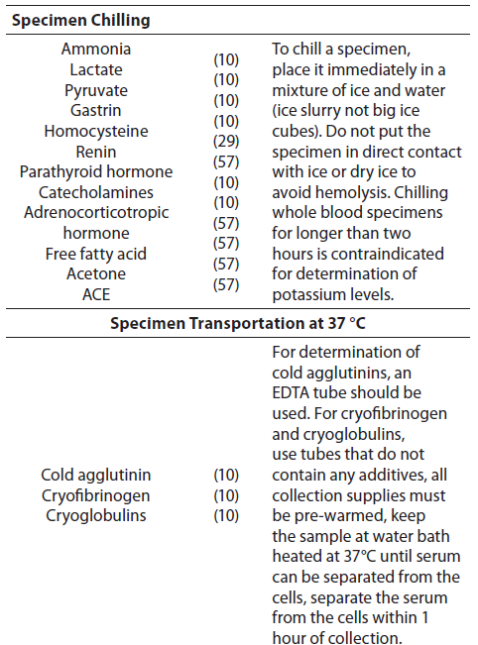
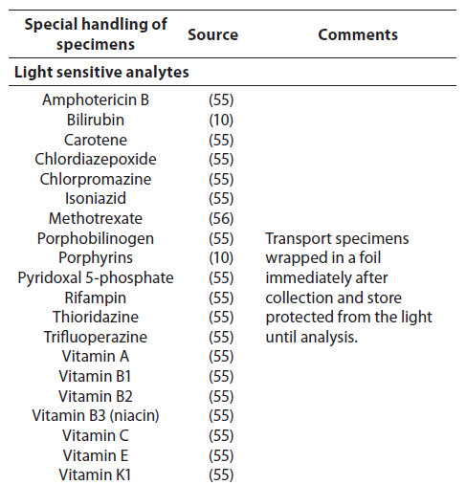
Sample transportation
The laboratory should be asked for advice on proper transport conditions.
You are in charge of the prompt and proper transportation of the samples you collected.
Nikolac N et al. Biochem Med 2013;23(3):242-54.

Slide 82
The quality of laboratory analyses depends to a large degree on correct preanalytical blood collection practices and sample handling for which you are responsible.
Deviation from the proposed Guideline might lead to false laboratory reports and potentially harms the patient!
Contact your laboratory if you are in any doubt or if you have any questions.

Slide 83

For more information (knowledge test, observation sheet, videos, …) visit the website of the
EFLM Working Group „Preanalytical Phase“
https://www.eflm.eu/site/page/a/1156

